Slide 1
Components

Slide 2

Component basics
Kinds of components Component anatomy Hooks
Overview
Router
Arranging and reuse

Slide 4
A Component
State
props
Returns jsx
<Component prop="value"/>

Slide 5
Components
Function
Class

Slide 6
Complexities around the use of classes
Why Function Components?
Functions in combination with hooks enable straightforward components creating structured apps

Slide 7
React re-renders a component when a prop or state value changes

Slide 8
A hook lets you hook into React’s internals in a function component.

Slide 9
A Component
State
props
Returns jsx

Slide 11
Router
<Router
<h1>
Hi there!
</h1>
<Switch>
<Route path="/about">
<About>
</About>
</Route>
..
<Route path = "/">
<FeaturedHouse/>
</Route>
</Switch>
</Router>

Slide 12
Router
<Router>
<h1>
Hi there!
</h1>
<Switch>
<Route path="/about">
www.react.com
<About>
</About>
</Route>
..
<Route path = "/">
<FeaturedHouse/>
</Route>
</Switch>
</Router>

Slide 13
Router
<Router>
<h1>
Hi there!
</h1>
<Switch>
<Route path="/about">
www.react.com/about
<About>
</About>
</Route>
..
<Route path = "/">
<FeaturedHouse/>
</Route>
</Switch>
</Router>

Slide 17
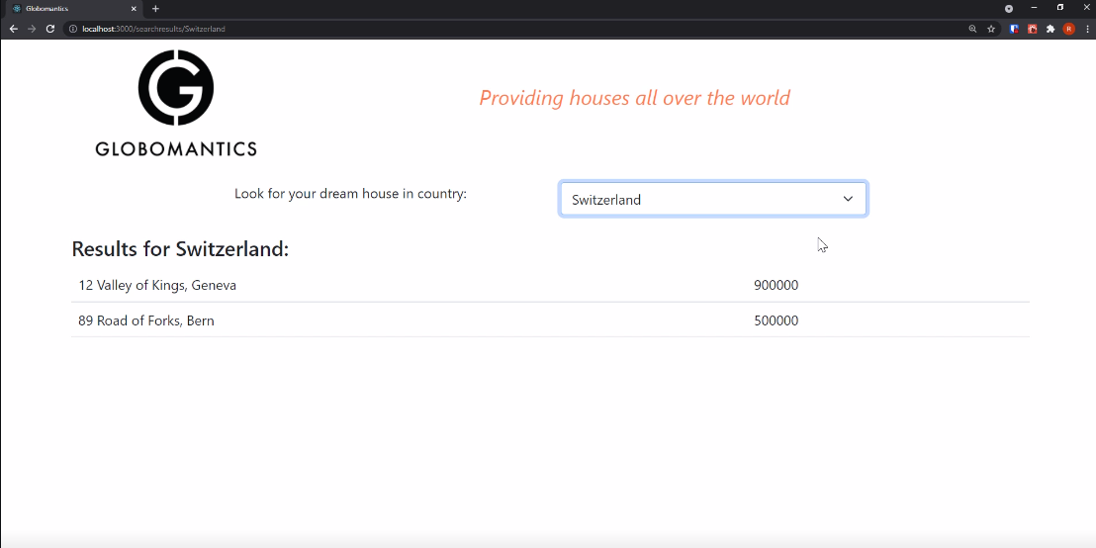

Slide 18
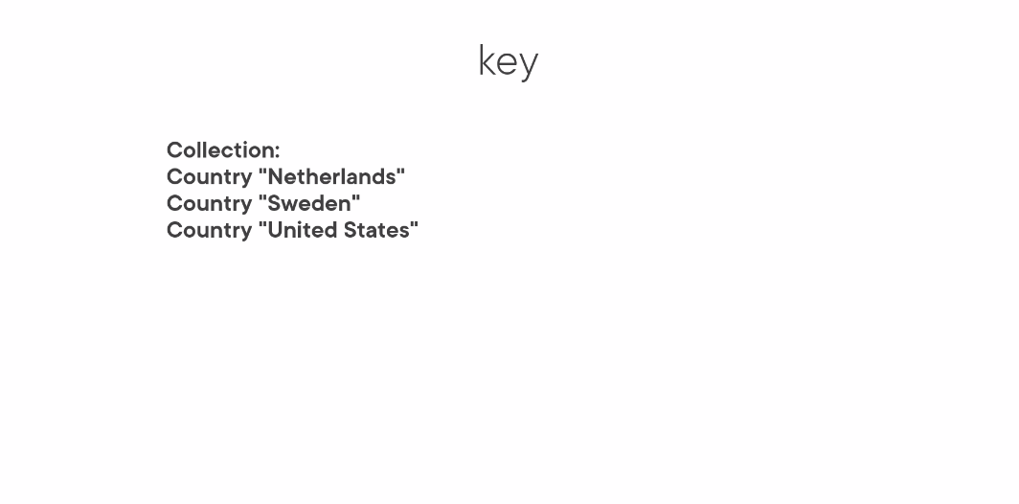

Slide 19
key
Collection:
Country "Netherlands" Country "Sweden" Country "United States"
Collection:
Country "The Netherlands" Country "Sweden" Country "United States"
Netherlands
The Netherlands
Sweden
Sweden
map
map
United States
United States

Slide 20
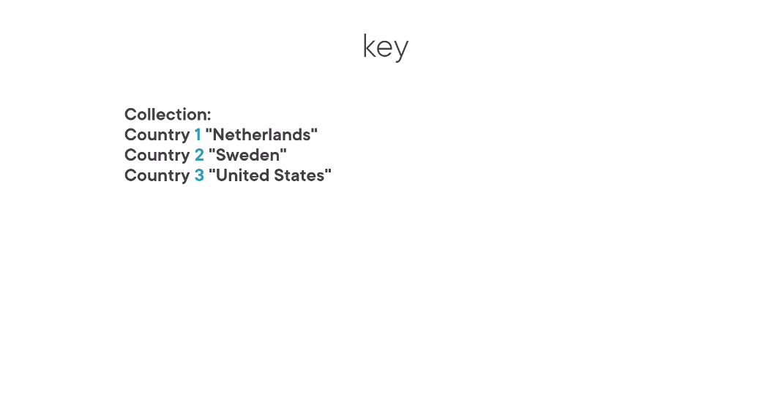

Slide 21
key
Collection:
Country 1 "Netherlands"
Country 2 "Sweden" Country 3 "United States"
1. Netherlands
2. Sweden
map
3. United States

Slide 22
The Order of Routes
<Router>
<Switch>
<Route path="/">
<FeaturedHouse house={featuredHouse} />
</Route>
www.react.com
<Route path="/search">
<SearchResults/>
</Route>
</Switch>
</Router>

Slide 23
The Order of Routes
<Router>
<Switch>
<Route path="/">
<FeaturedHouse house={featuredHouse} />
</Route>
www.react.com/search
<Route path="/search">
<SearchResults/>
</Route>
</Switch>
</Router>

Slide 24
The Order of Routes
<Router>
<Switch>
<Route path="/">
<FeaturedHouse house={featuredHouse} />
</Route>
www.react.com/search
<Route path="/search">
<SearchResults/>
</Route>
</Switch>
</Router>

Slide 25
The Order of Routes
<Router>
<Switch>
<Route exact path="/">
<FeaturedHouse house={featuredHouse} />
</Route>
www.react.com/search
<Route path="/search">
<SearchResults/>
</Route>
</Switch>
</Router>

Slide 26
The Order of Routes
<Router>
<Switch>
<Route path="/search">
<SearchResults/>
</Route>
www.react.com/search
<Route path="/">
<FeaturedHouse house={featuredHouse} />
</Route>
</Switch>
</Router>

Slide 28
Function components
Props
Summary
Value references
Hooks Router
Tips

